Slide 1
The Battle of Neighborhoods
Finding a good movie theatre location in Hong Kong

Slide 2
Our Brief
Undertake an analysis of potential cinema location according to its nearby environmental factors.
Our Audience
My boss, a potential movie theatre investor
2

Slide 3
Business problem
The questions to be answered:
What are the location of cinemas and what’s their distribution like?
Where should the potential investor invest in or investigate further?
3

Slide 4
Data required
1. Geographic coordinate of Hong Kong cinemas
I need to compare 5 possible locations with current cinemas in Hong Kong. Therefore, I need to find a list of Hong Kong cinema and cinemas' geographic coordinates. Luckily, I can find the list and coordinates from the website https://hkmovie6.com/cinema
2. Geographic coordinates of 5 possible cinema addresses
Geographic coordinates of 5 possible cinemas are required and I can use Google Map API to find this information.
3. Favourite cinema list of boss
The favourite cinema list of boss is an important information to be used for analysis.
4. Eating, Shopping and Public transportation facility around cinema
The recommended cinema location needs to have as many eating and shopping venues nearby as possible. Convenient public transport is also an important factor.
These data can be found by using FourSquare API to find these venues around the location. The radius of exploration distance is set to 500 meters, which is about 5 minutes walking distance.
4

Slide 5
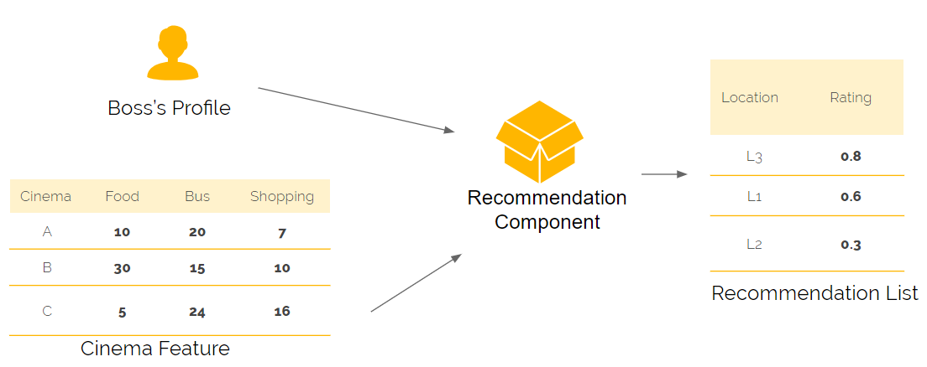
Methodology
5

Slide 6
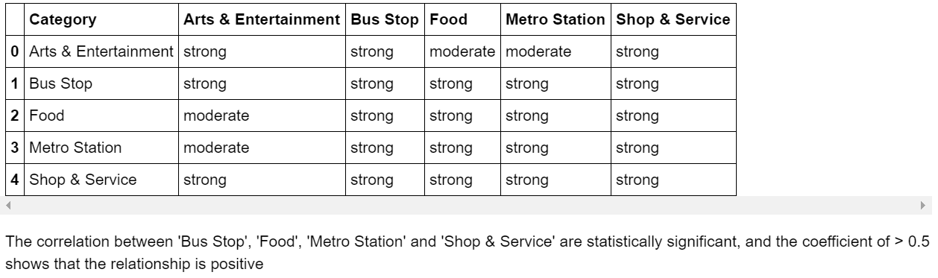
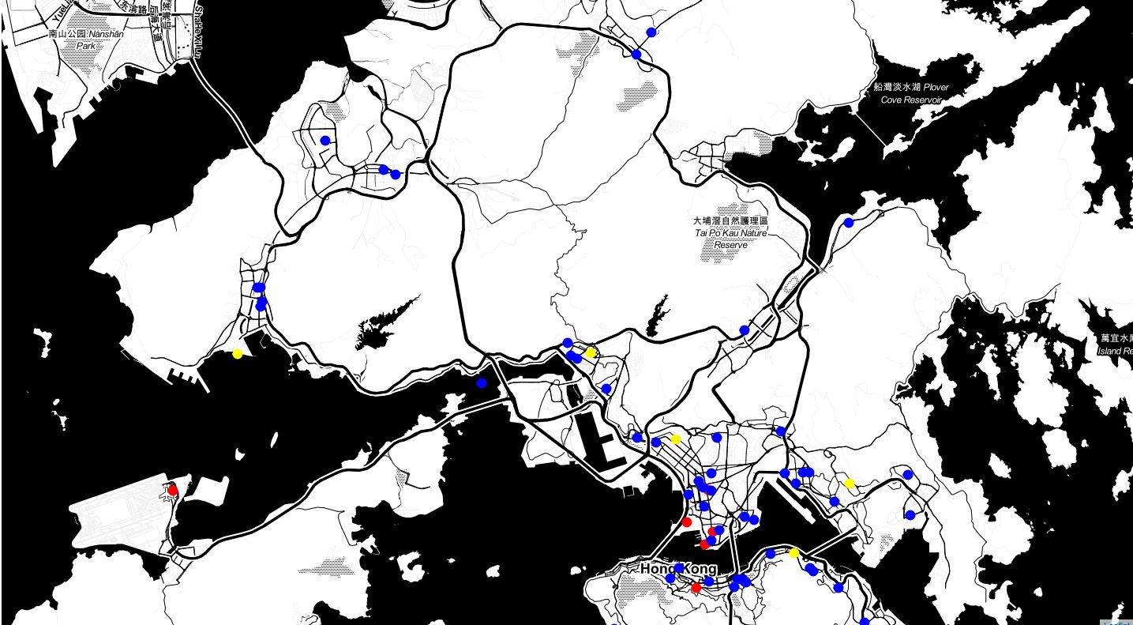
Results
Underlying preferences from the boss’s chosen cinema to drive the recommendation system ML algorithm
6

Slide 7
Conclusion
A recommendation has been put forward to the boss, based on his inherent preference of cinemas (as per the analysis, the number of venues in eating, shopping, transportation category near the cinema).
This technique to identify individual preferences (i.e. they choices) and using these preferences to identify inherent traits for choices seems to work well in my organisation for analysis. As per previous sessions, the data sources are probably outdated and any new data may help improve the accuracy of the results.
The technique is also blunt. It doesn’t take into account other factors that influence individual choices (e.g. where the boss lives, and his lifestyle factors), which may impact on his choices. A detailed, more qualitative and quantitative research may reveal further preferences and allow us to recommend a commercial location for a cinema better.
In addition, this analysis doesn’t take into account any commercial aspect of a decision (e.g. rent, commercial availability..etc).
7

